Slide 1


PROJECT SEM 2
Web Application Development
Project Name: Make an Appointment for a Clinic
Instructors : Mr. Nguyen Tuan
Students : Doctor Care
Hà Nội , Ngày 14 Tháng 9 Năm 2022.

Slide 2

Member
Nguyen Hoang Son(Leader)
Do Thi Thao
Nguyen Viet Duc
Cao Quoc Trung
Do The Duc
Team: Doctor Care

Slide 3
Content :
Overview of the group topic and products
Use case
Database Design
Technology used
Product Design
Parts have been and are being completed
Team: Doctor Care

Slide 4
Overview of the group topic and products
Next steps
Team: Doctor Care

Slide 5
Why do you need this Web App?
Overview of the group topic and products
Health is one of the key factors in today's modern classroom and we need to put it first.
With the increase of disease and the large number of urban population, it becomes difficult to go to the doctor.
There may be a situation where some people want to have their health checked, their current medical condition etc., and for this purpose, they need to visit the clinic.
Team: Doctor Care
Notes:
- Sức khỏe là một trong những yếu tố quan trọng trong thời buổi hiện đại ngày nay và cần được chúng ta đặt lên hàng đầu.
- Với sự gia tăng của bệnh tật và số lượng lớn dân cư thành thị, việc đi khám bệnh trở nên khó khăn.
- Có thể có tình huống một số người muốn kiểm tra sức khỏe, tình trạng bệnh hiện tại của mình v.v ... và vì mục đích này, họ cần đến phòng khám.

Slide 6
Proposed solutions
Overview of the group topic and products
But there is a case of busy working, there is not much time to wait when going to the clinic to wait for the doctor's turn.
So we came up with a solution help them by allowing them to book appointments online so that they have priority over waiting.
An appointment booking web application created to help people book appointments according to specialties, examination times to suit themselves.
Team: Doctor Care
Notes:
- Nhưng có một só trường hợp bận rộn do công việc, không có nhiều thời gian chờ đợi khi đến phòng khám để chờ đến lượt khám. Nên chúng tôi đã đưa ra một giải pháp
giúp họ đó là cho phép họ đặt lịch khám online để họ có được sự ưu tiên hơn là chờ đợi.

Slide 7

Project size
Overview of the group topic and products
This application also helps the clinic to control the information of people who book appointments by specialty, time of day visits and feedback from customers with the clinic.
Manage the doctors working in the clinic according to each specialty.
Team: Doctor Care
Notes:
- Ứng dụng này còn giúp phòng khám kiểm soát được thông tin những người đặt lịch theo chuyên khoa, thời gian khám theo ngày và phản hồi từ khách hàng với phòng khám.
- Quản lý được các bác sĩ làm việc tại phòng khám theo từng chuyên khoa.

Slide 8
Use case
Next steps
Team: Doctor Care

Slide 9
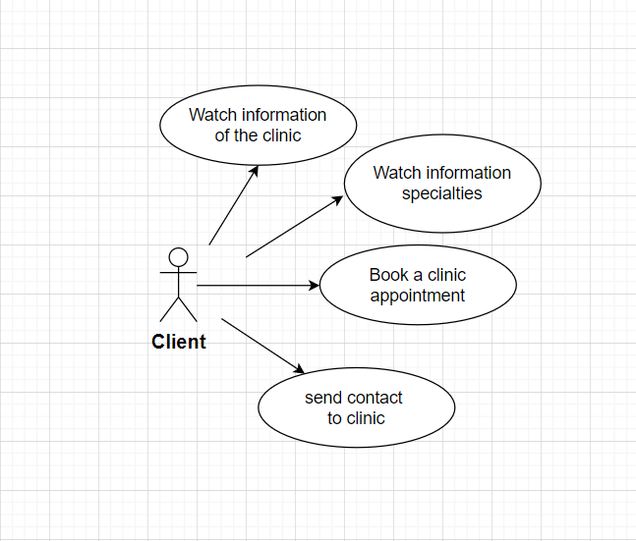
Theoretical basis
Client:
Team: Doctor Care

Slide 10
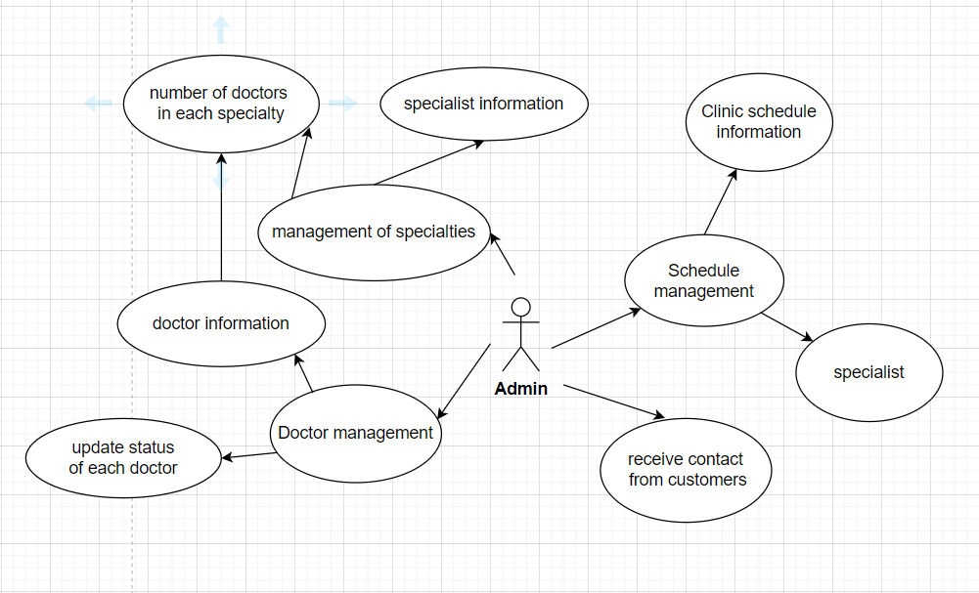
Theoretical basis
Admin:
Team: Doctor Care

Slide 11
Database Design
Next steps
Team: Doctor Care

Slide 12
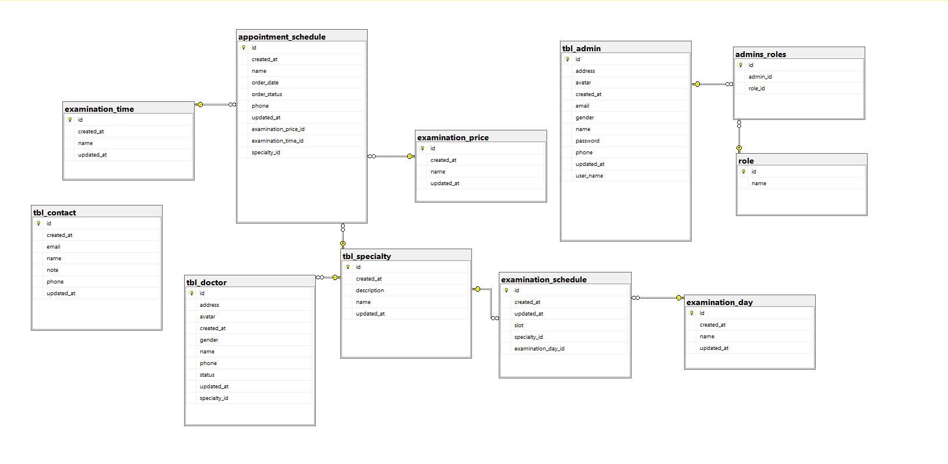
Theoretical basis
Team: Doctor Care

Slide 13
Technology used
Next steps
Team: Doctor Care

Slide 14
Theoretical basis
Front-end:
HTML
CSS
JavaScript
thymeleaf
Back-end:
Java
Spring Boot
SQL server
Support software:
IntelliJ IDEA 2022
Visual Studio Code
GitHub
Team: Doctor Care

Slide 15
Product design
Next steps
Team: Doctor Care

Slide 16
Functional requirements
Application functions for users
Home Page: Including the interface to introduce the clinic and services, the menu has many diverse functions, including basic functions such as booking an appointment and receiving customer opinions.
Make an appointment: Customers enter personal information, choose a specialty, determine the date of the examination, select the examination time frame and service price.
Contact: Customers enter their personal information and opinions about what needs to be consulted and helped for the clinic to receive and respond to.
Team: Doctor Care

Slide 17
Functional requirements
Application functions for admin
Register & Login : Register an account, log in to the system to allow admin to manage the clinic's information.
Information customer manage: Manage client's appointment and contact information
Information clinic manage : Manage doctor information, specialties, clinic's working schedule.
Team: Doctor Care

Slide 18

Main Page

Slide 19
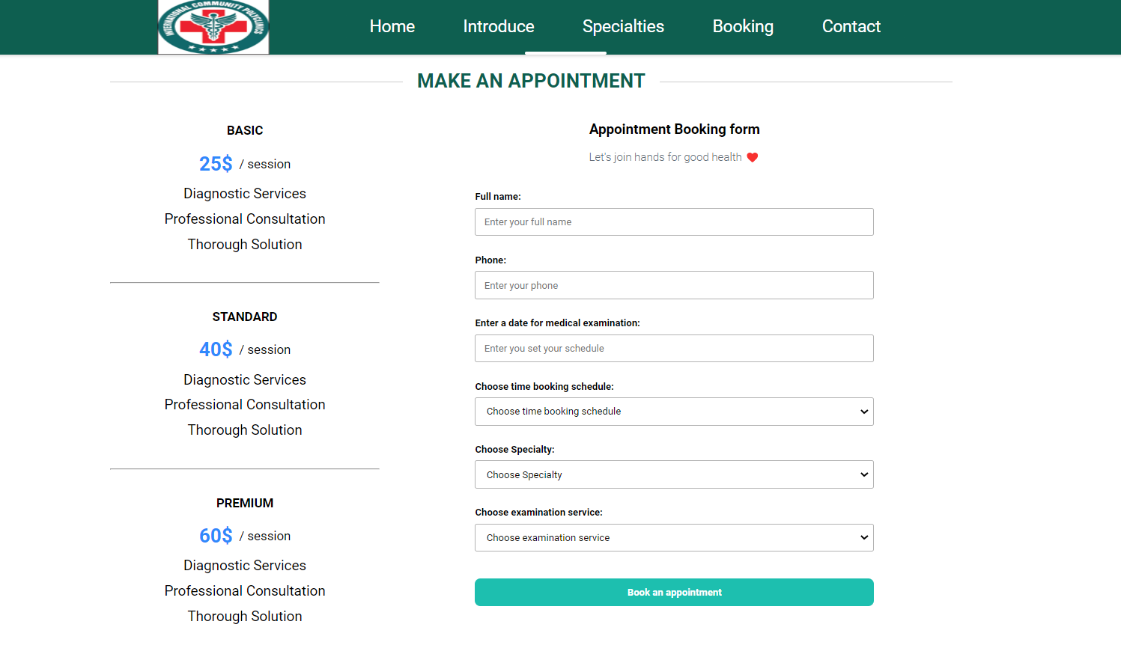
Booking Page

Slide 20
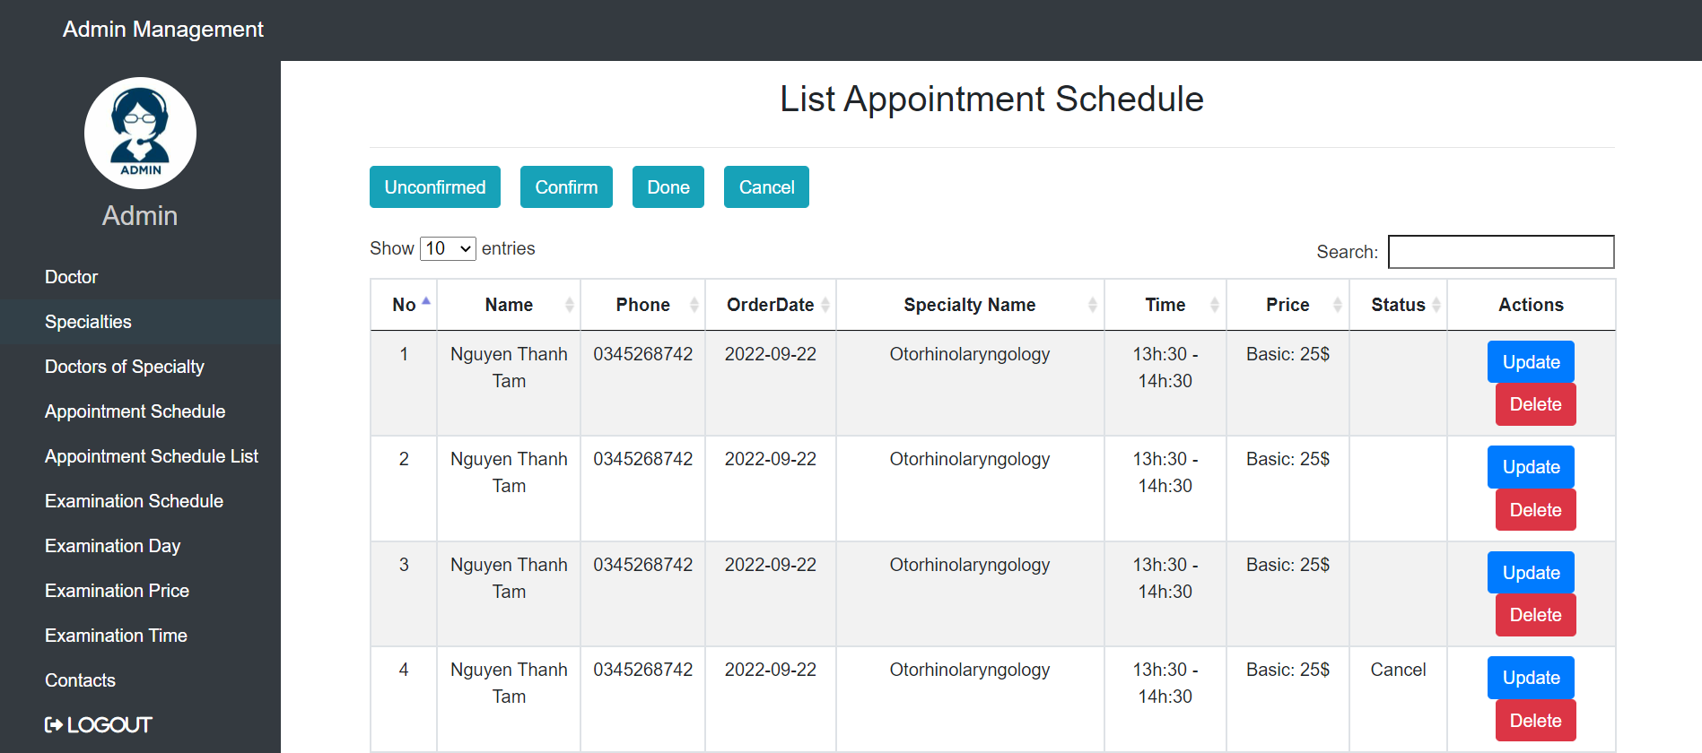
AppointmentSchedules

Slide 21
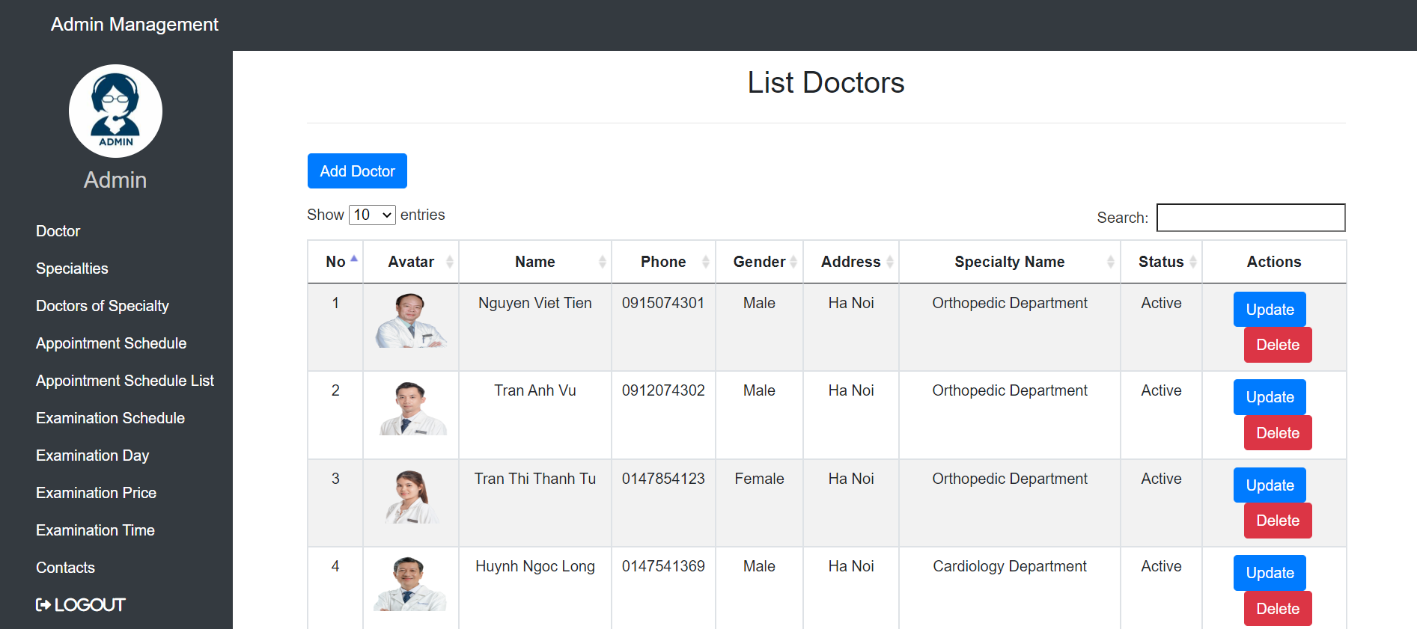
Doctors List

Slide 22
Parts have been and are being completed
The parts that have been done:
The main flow of the problem has been built: the customer can book an appointment online
Admin: Manage appointments, doctors, specialties of the clinic
Unfinished parts:
The management system has many shortcomings
After making an appointment, customers still have to wait for a response from the clinic
We will try to absorb and improve from the comments of the teachers.
Team: Doctor Care

Slide 23
FPT Aptech Ha Noi
Thank you teachers and friends for watching
Hà Nội , Ngày 14 Tháng 9 Năm 2022.

